Slide 1
Smart Application Generator
https://github.com/XiangkunYe/Tensorflow-Application-Generator
Xiangkun Ye
Zhangyu Wan
Yuxuan Su

Slide 2
01
System Diagram
02
CONTENTS
Accomplishments
03
Demo
04
Next Step

Slide 3
System Diagram
01
Reintroduction of our system, include using of Neurela.

Slide 4
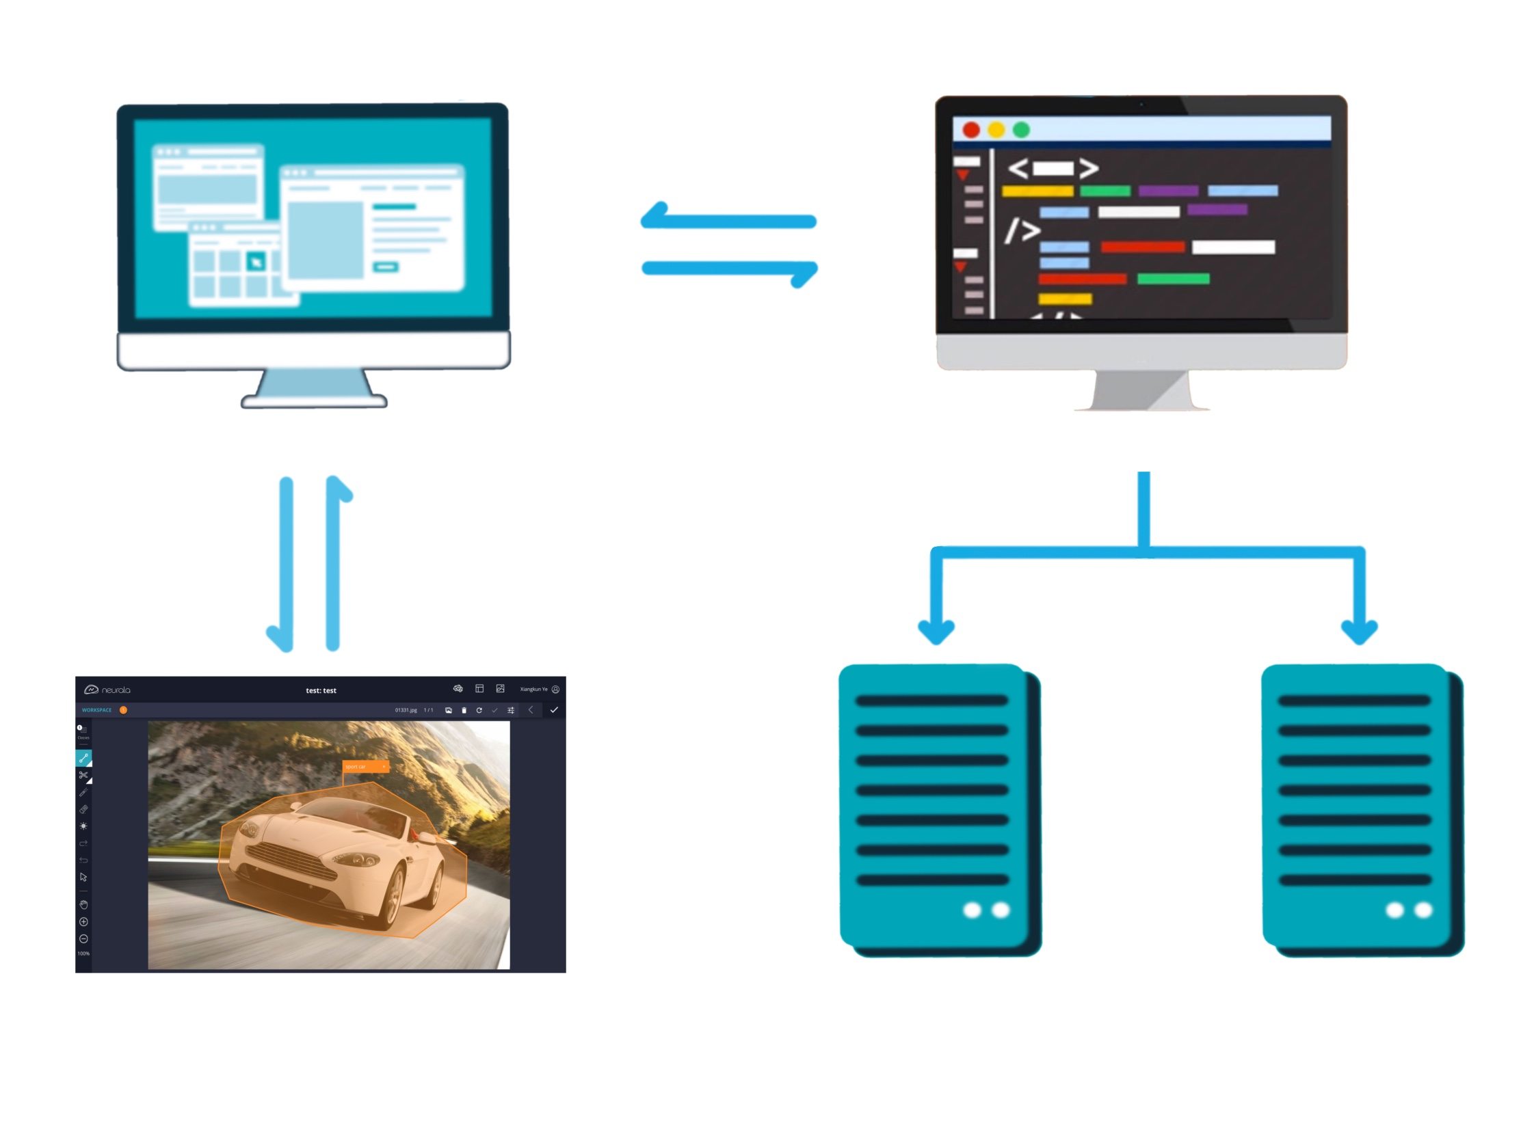
System Diagram
Front end
Back end
Neurela
Train Model
Package APK

Slide 5
Accomplishments
02
Our works during sprint 2.

Slide 6

Accomplishments
Tools
Learn and be familiar with tools we are going to use.
Tensorflow and Keras for computer vision and Neurela for labeling.
Image Classification
We used Tensorflow and Keras to bulid a 3 lays convolutional neural network that can recognize and classify images based on train data we provide.
Image Segmentation
We also built a U-Net model based on some open source projects on Github that can not only recognize but also mask the position of our target.

Slide 7
Demo
03
Demo our work with code and output of image classification and segmentation.

Slide 8
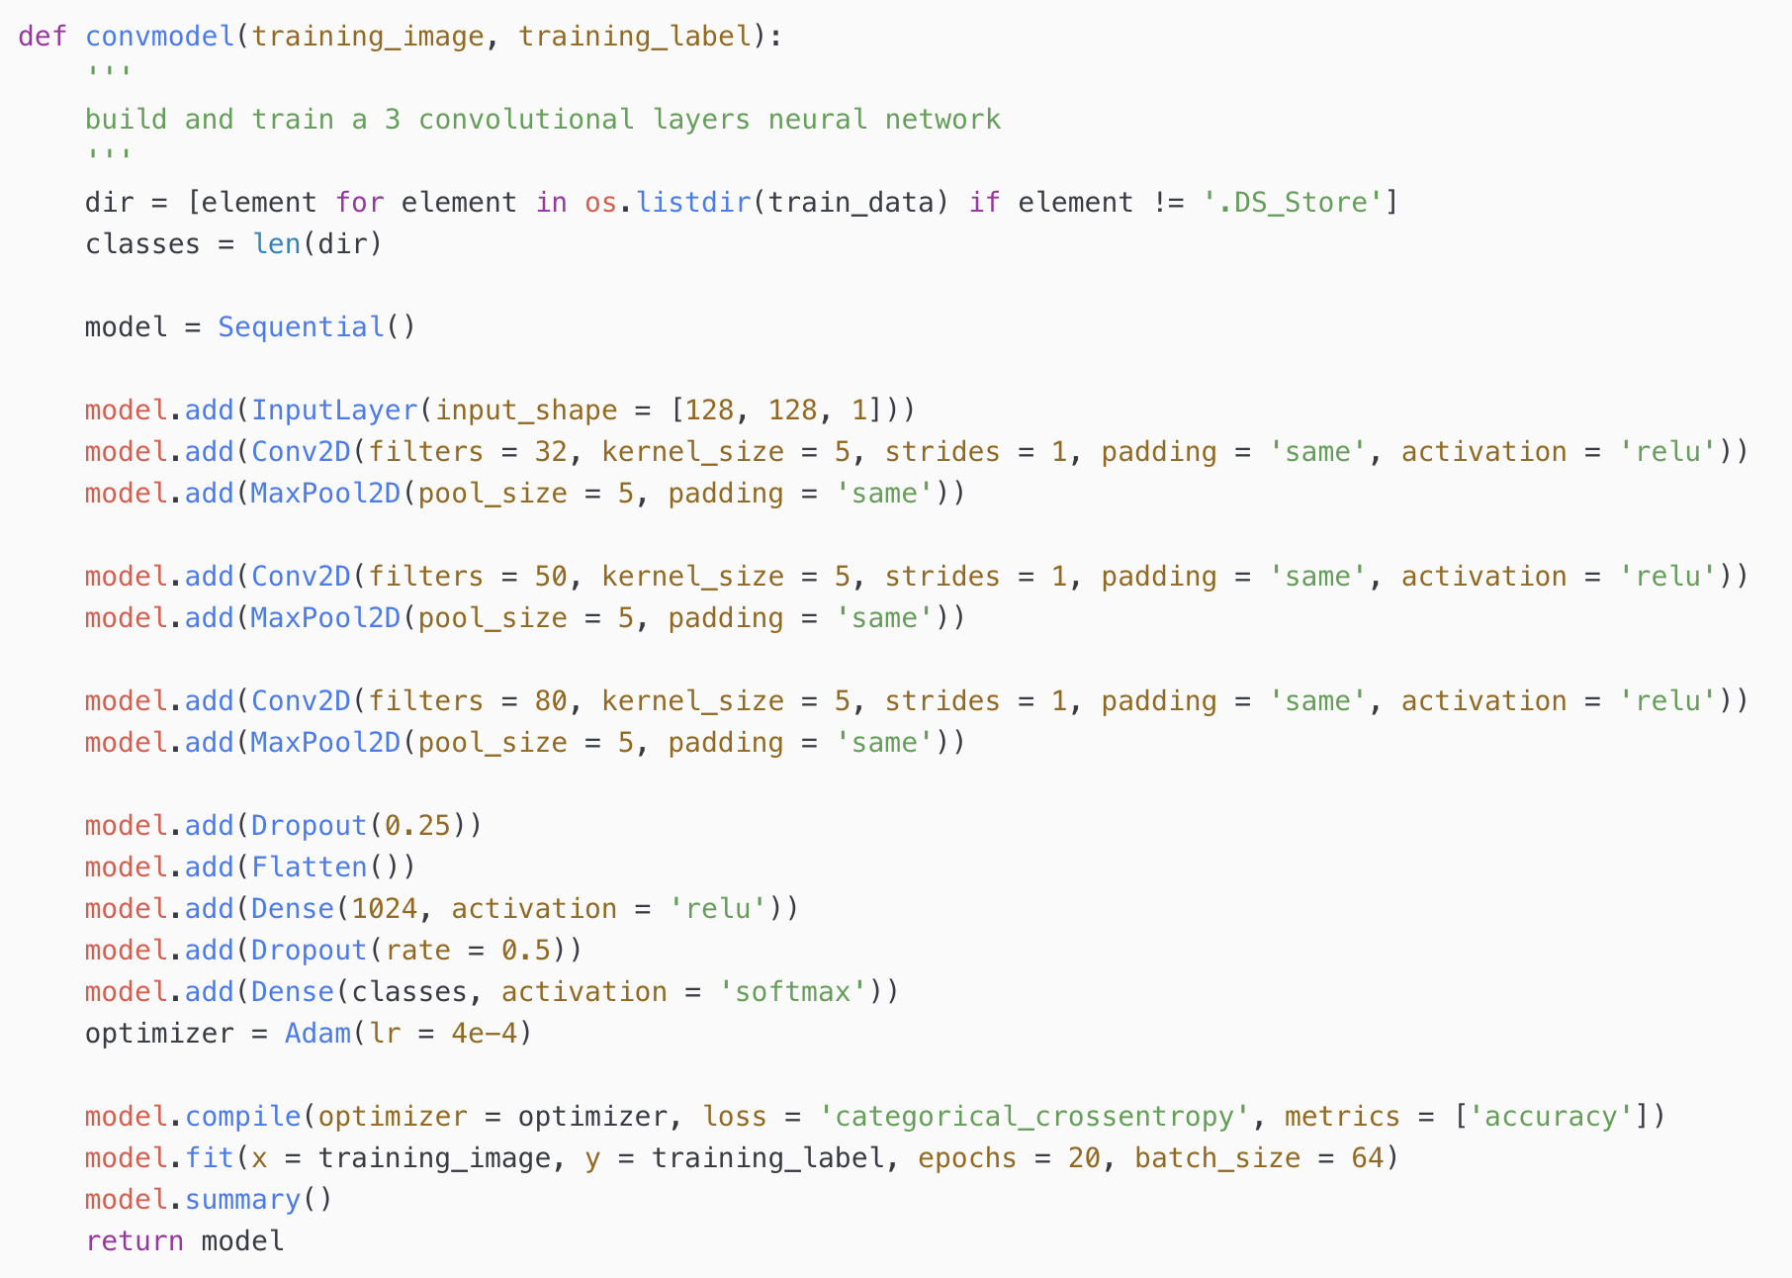
Demo: Image Classification

Slide 9
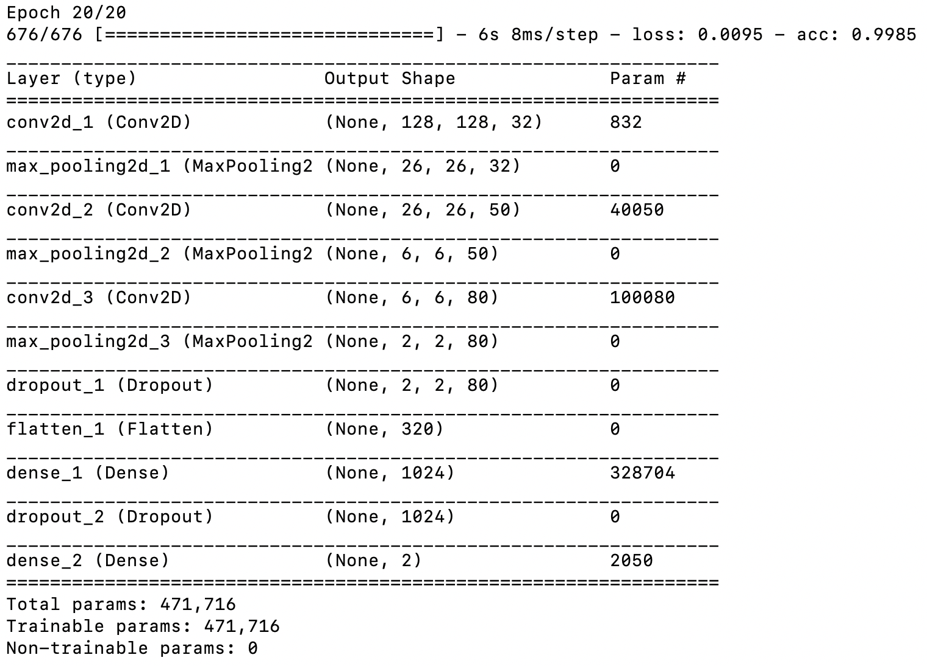
Demo: Image Classification

Slide 10
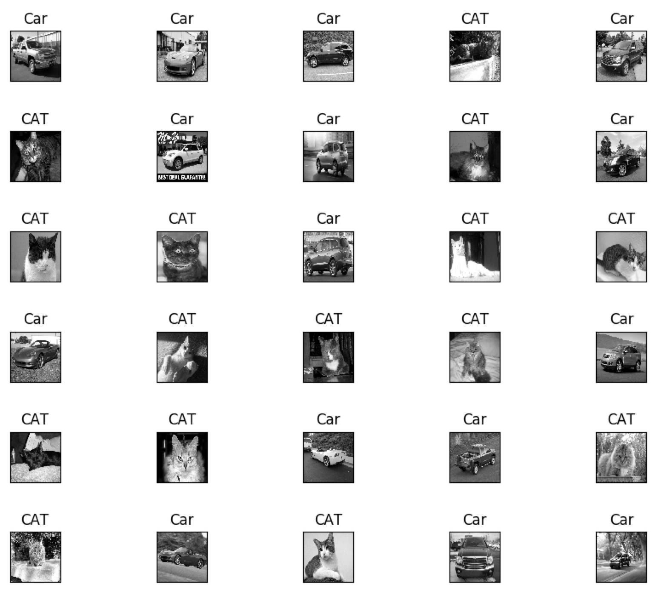
Demo: Image Classification

Slide 11

Demo: Image Segmentation

Slide 12
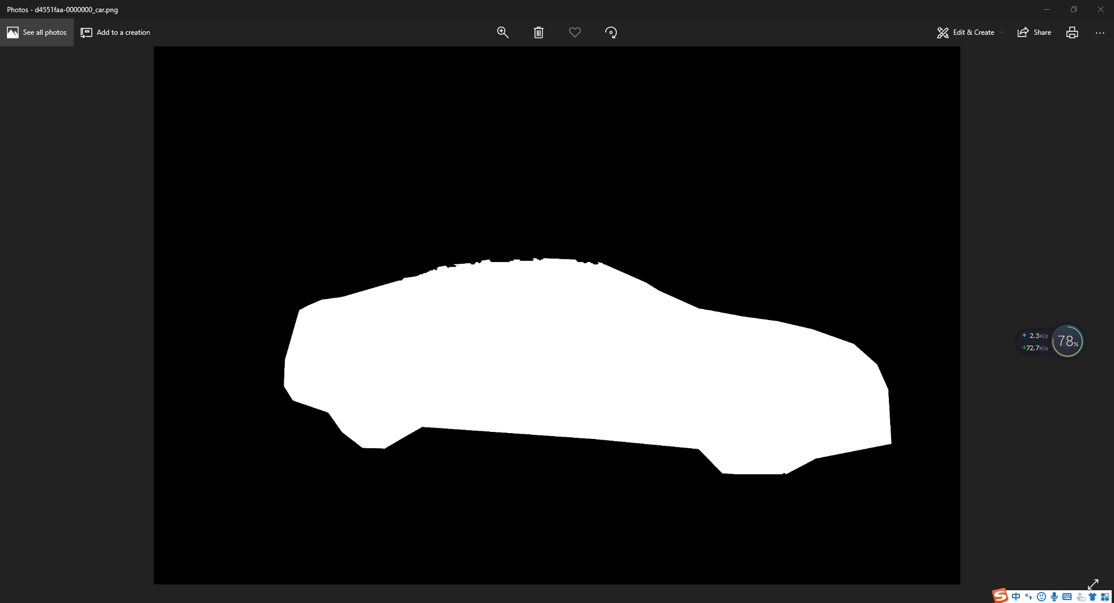
Demo: Image Segmentation

Slide 13
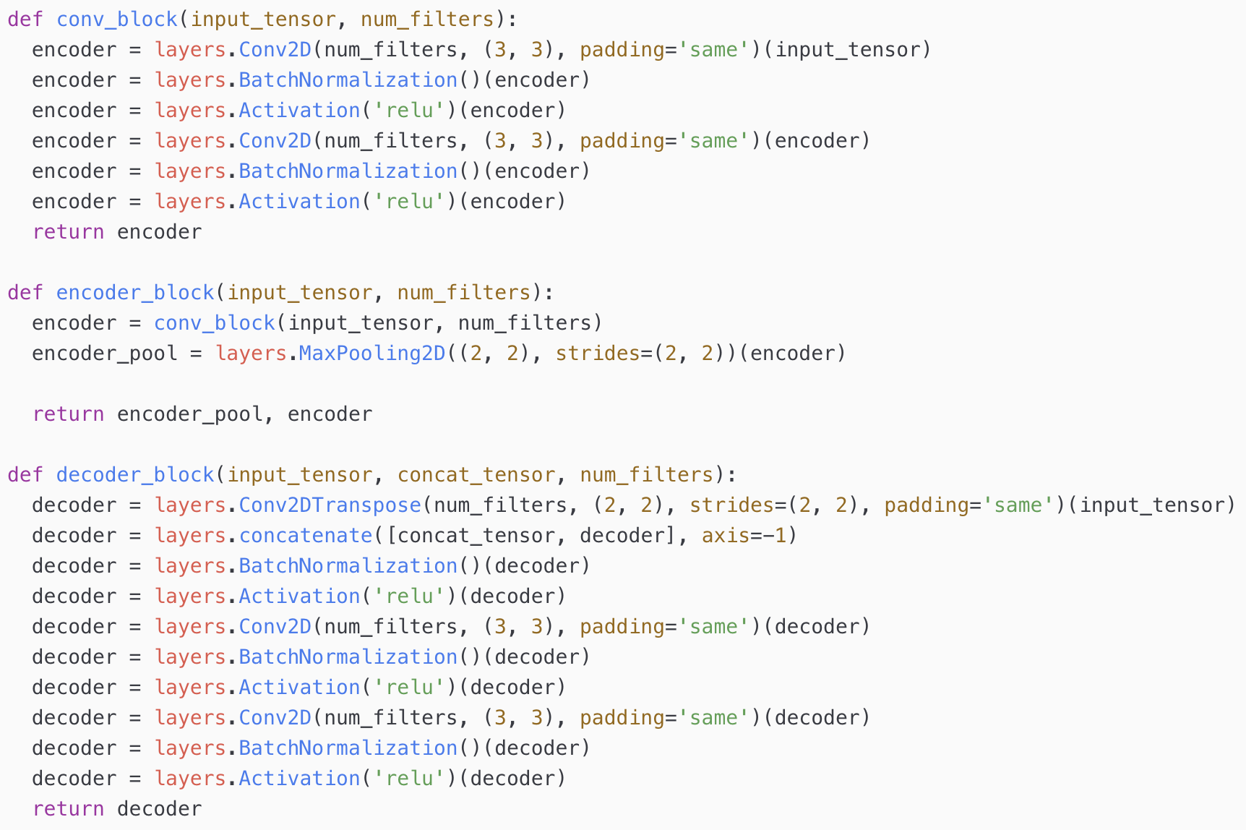
Demo: Image Segmentation
Notes:
We'll build the U-Net model. U-Net is especially good with segmentation tasks because it can localize well to provide high resolution segmentation masks. In addition, it works well with small datasets and is relatively robust against overfitting as the training data is in terms of the number of patches within an image, which is much larger than the number of training images itself. Unlike the original model, we will add batch normalization to each of our blocks.
The Unet is built with an encoder portion and a decoder portion. The encoder portion is composed of a linear stack of Conv, BatchNorm, and Relu operations followed by a MaxPool. Each MaxPool will reduce the spatial resolution of our feature map by a factor of 2. We keep track of the outputs of each block as we feed these high resolution feature maps with the decoder portion. The Decoder portion is comprised of UpSampling2D, Conv, BatchNorm, and Relus. Note that we concatenate the feature map of the same size on the decoder side. Finally, we add a final Conv operation that performs a convolution along the channels for each individual pixel (kernel size of (1, 1)) that outputs our final segmentation mask in grayscale.

Slide 14
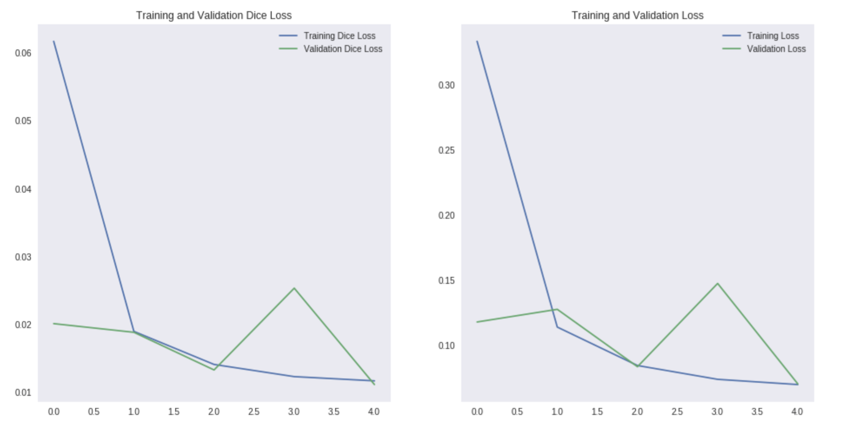
Demo: Image Segmentation
Notes:
fluctuation

Slide 15
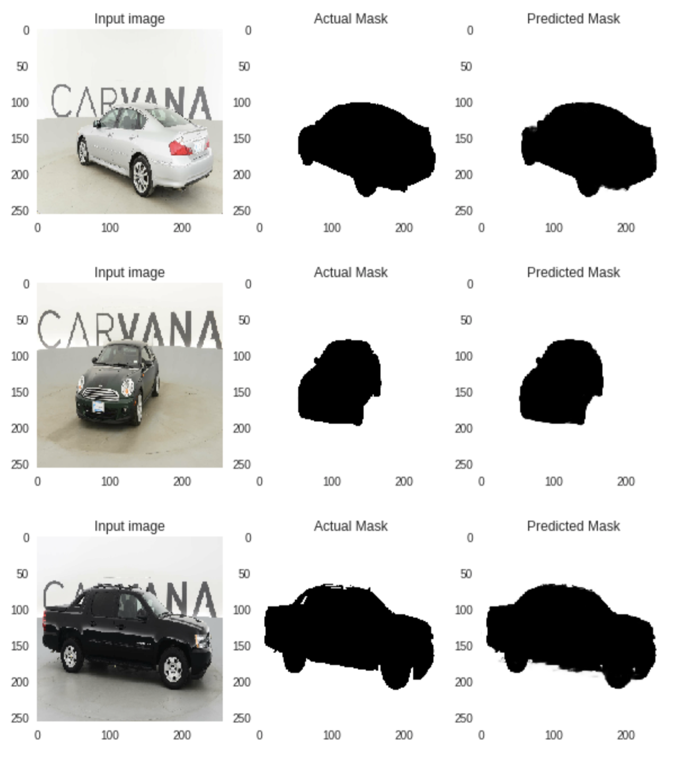
Demo: Image Segmentation

Slide 16
Next Step
04
Our plan for Sprint 3.

Slide 17

Next Step
Front-End:
UI design:
User Sign-in & Sign-up;
Images & labels upload;
trained Model download;
Back-End:
Deep Learning Model Training Module:
compare the performance of different neural network model;
improve trained model's avg accuracy;
Database Design:
Store Users' information
Store Images' location in storage system
17

Slide 18
Thanks for Attention

